Slide 1


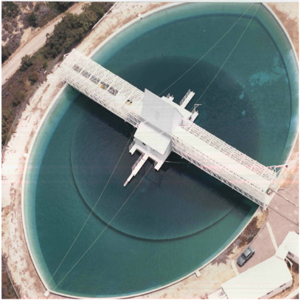
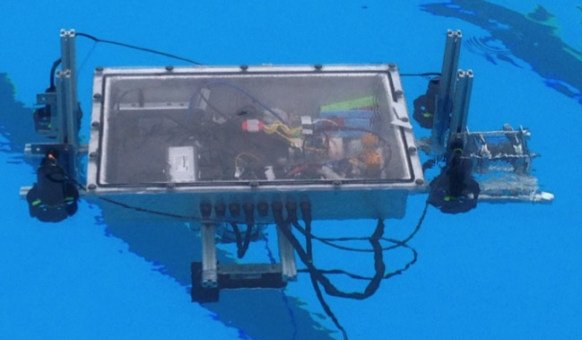
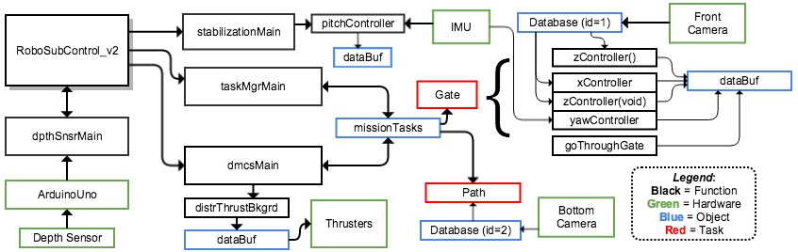
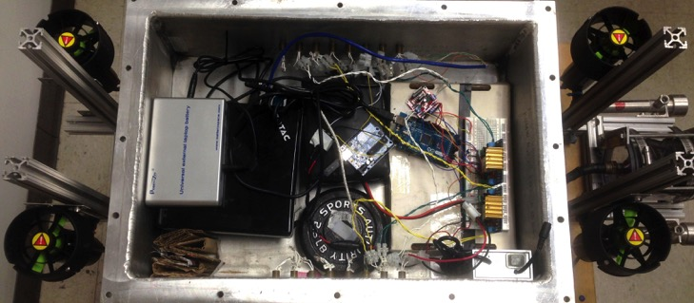

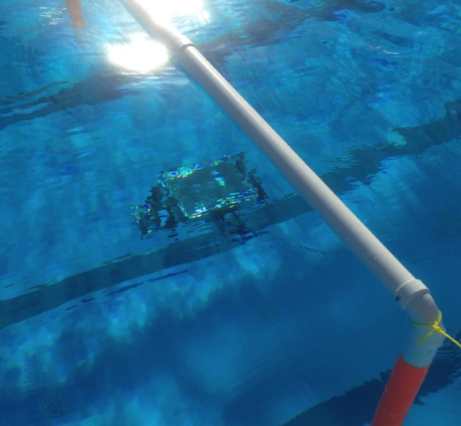
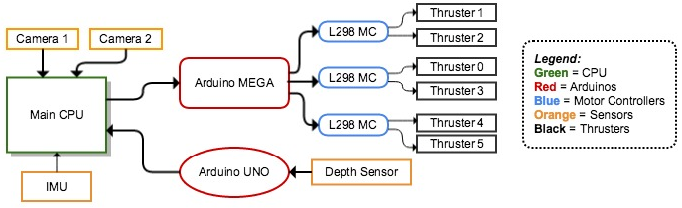
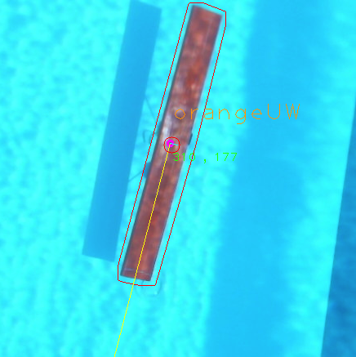
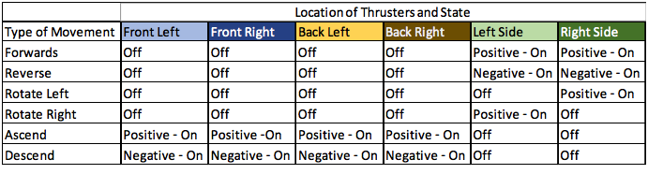
RoboSub
Dennis Boyd, Bjorn Campbell, Samantha Cherbonneau, Kevin Matungwa, Elliot Mudrick
Advisor: Dr. Michael Frank
Background
System Level Design – Software
Final Schedule
Competition hosted by AUVSI in San Diego, CA (July 20-26, 2015)
Sub must operate autonomously
Sub must pass through validation gate to participate in competition
Competition involves various tasks that require: color/shape recognition, change depth/direction/speed, ability to grab/place items
Decision Making: state machine where each state corresponds to a task command at the top to the stack
Vision: using the OpenCV library for color recognition and object tracking
Stabilization: internal gyroscope used with PID controller to correct the yaw and pitch to keep the sub stable while in motion
Movement: done by programming the thrusters through the Arduino Mega
Depth Control: readings are taken from the depth sensor and depending on those values, the thrusters are adjusted using PID controller to maintain specific depth
Design Specifications
Weigh less than 125 lbs
Dimensions smaller than 6’ x 3’ x 3’
Have kill switch
Build off of previous years’ hull and hardware design
Final Budget
System Level Design – Hardware
Proper weight distribution must be maintained within the sub to ensure it moves smoothly
Testing
Majority of testing took place at Morcom Aquatic Center
Mock validation gate and orange path constructed
Sub successfully recognizes gate and moves through it
Bottom camera recognizes sub and calculates angle
The depth sensor is connected on the bottom of the sub for more accurate readings and allows the sub to maintain a depth within approx. +/- 1 ft from specified depth
Conclusion
Great progress with basic functionality: can maintain depth effectively while stationary and moving, can maintain yaw/pitch
The front camera can recognize certain objects (i.e. orange gate) and act in response to them
Bottom camera is fully functional and can calculate the angle of orange paths and update the database
Improved thruster orientation allows for better movement
Team Member Responsibilities
Dennis Boyd – Lead Programmer, Tester
Bjorn Campbell – Lead Electrical Engineering, Tester
Samantha Cherbonneau – Web Developer, Secretary, Tester, Assistant Programmer
Kevin Matungwa – Programmer, Tester
Elliot Mudrick – Project Leader, Assistant Programmer, Tester

